Slide 1

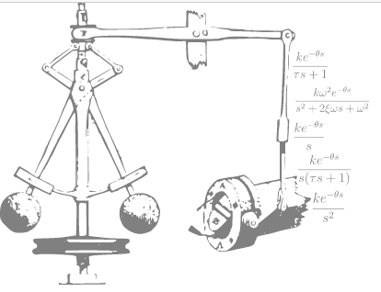
PID Tuner
In Practice
https://pidtuner.com

Slide 2
FAQ
What data do I need to import?
How do I make a step test?
What are the models used for?
How to set the performance slider?
https://forum.pidtuner.com

Slide 3
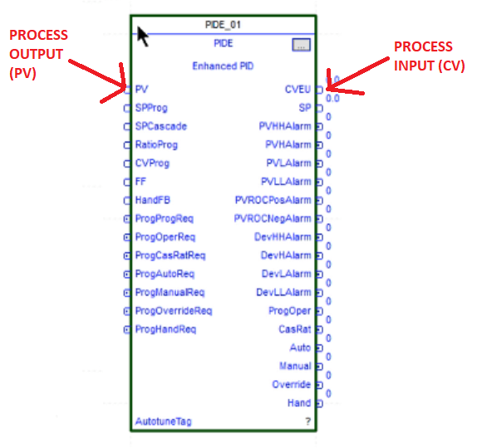
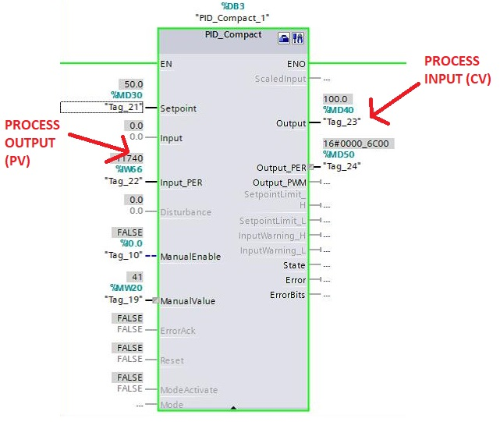
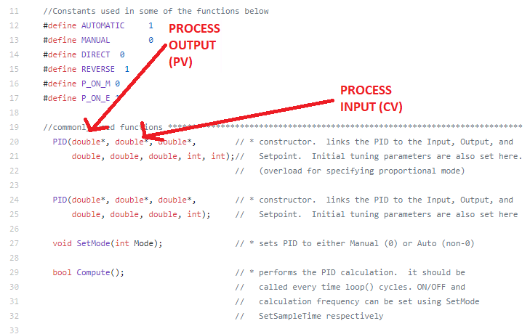
What data do I need to import?
Time, Input and Output? Of the Process!
But what is “the Process”? Everything that is not the PID.
Where is the PID? A block of code that has PV (Process Variable) and SP (Setpoint) as inputs, and the CV (Control Variable) as output.

Slide 4
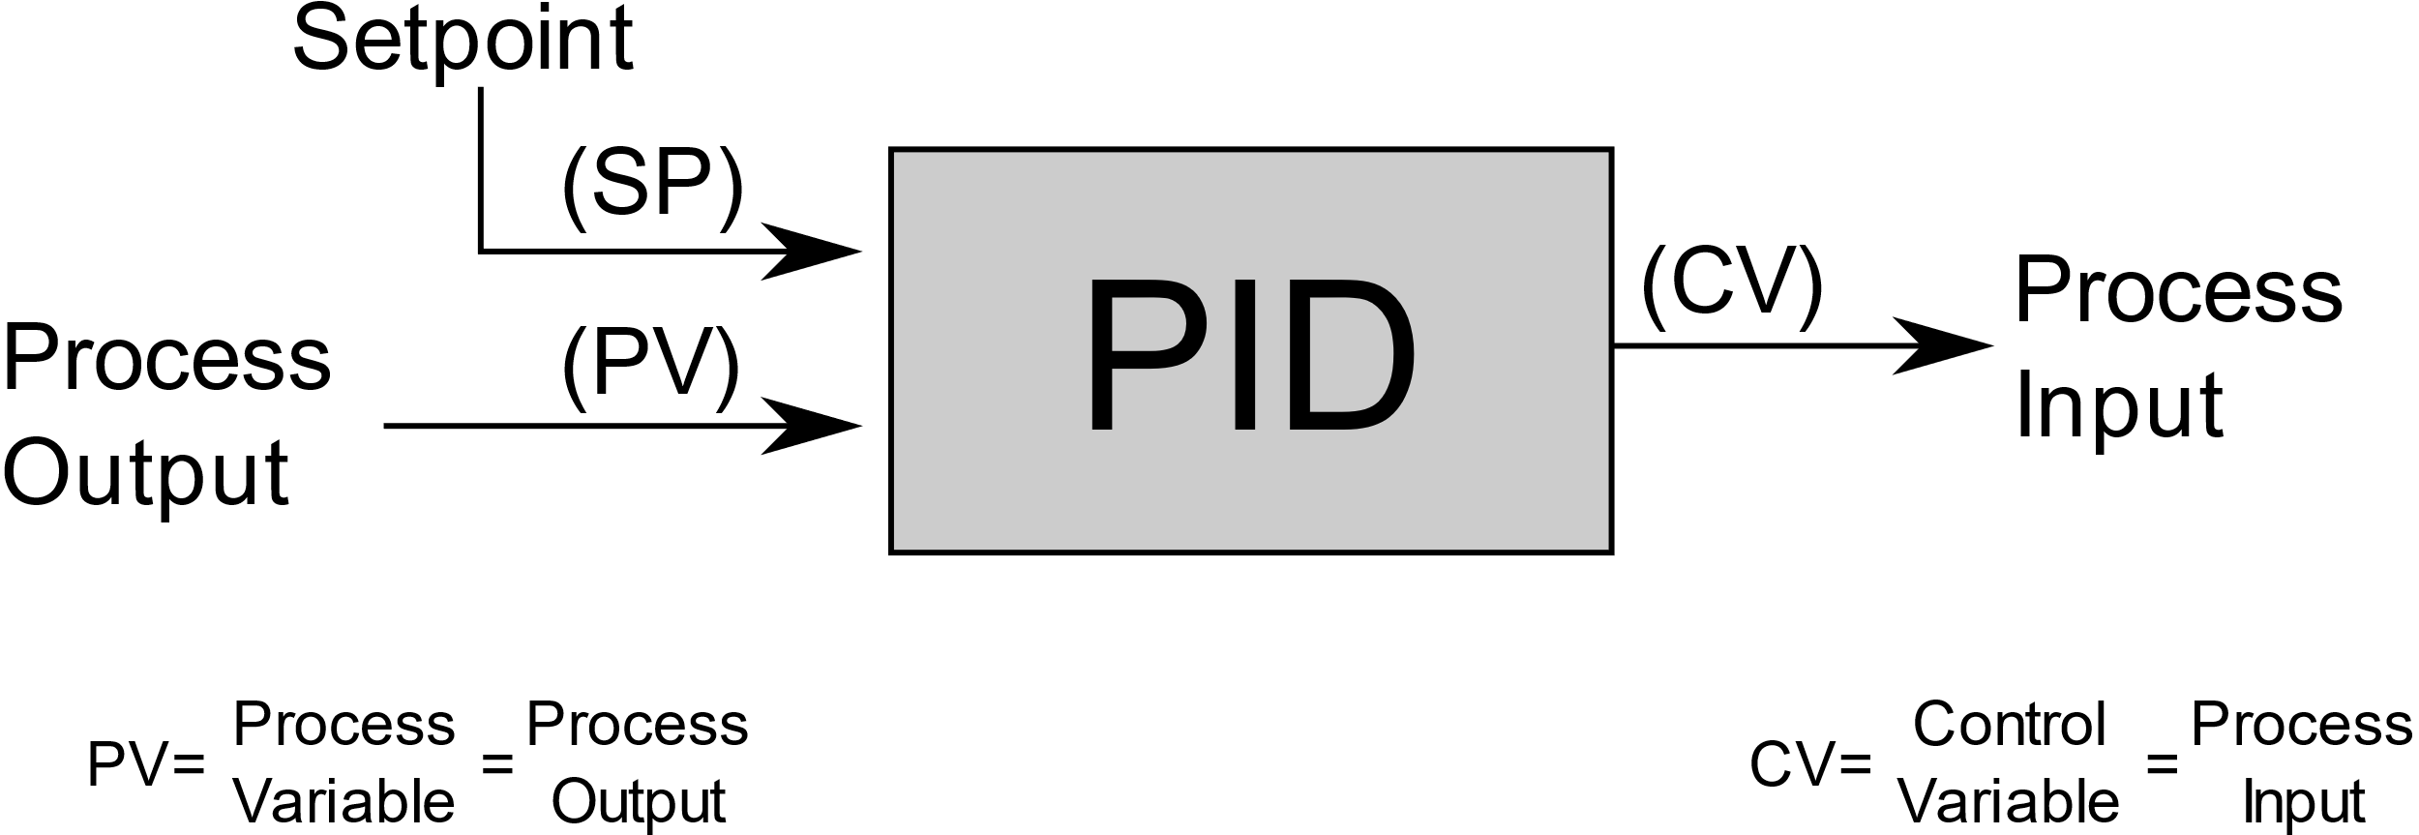
Time, Input and Output
If the process is everything that is not the PID then:
The CV is the Process Input and,
The PV is the Process Output
Time must always be in seconds.

Slide 5
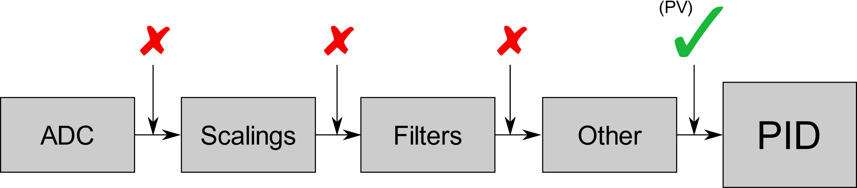
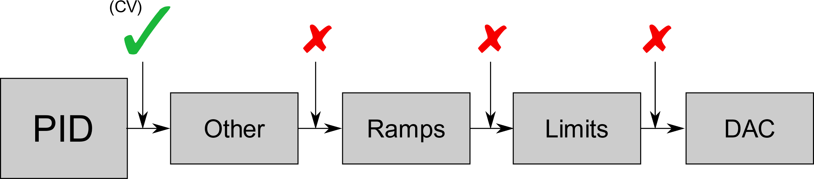
Common Mistakes on Data
Considering filters, ramps, scalings and other transformations.
Need as Output exactly what comes into the PID (as PV).
Need as Input exactly what comes out of the PID (as CV).

Slide 6
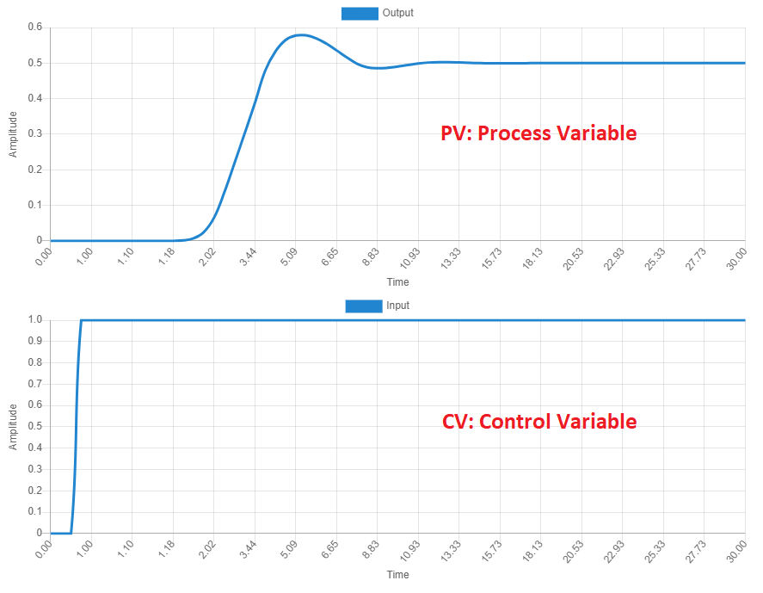
What is a step test?
Consists in making a manual step change in the CV (Process Input), to observe how it affects the PV (Process Output).
A common mistake is to make the step change in the SP (Setpoint), when it must be done in the CV.

Slide 7
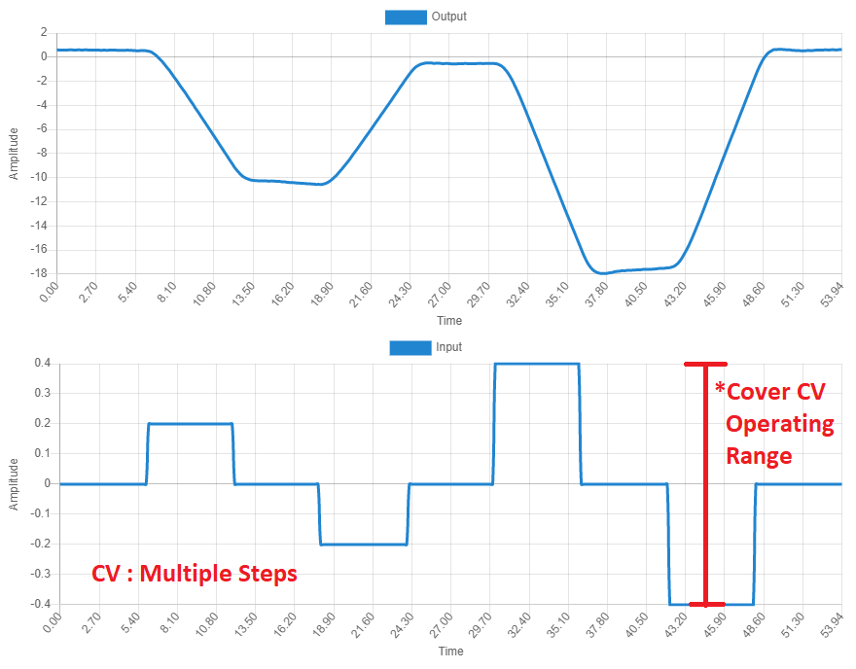
How do I make a step test?
Step must be done with loop in “manual” (PID turned off).
Avoid violating process limits.
Record one or more steps.
Cover the CV operating range.

Slide 8
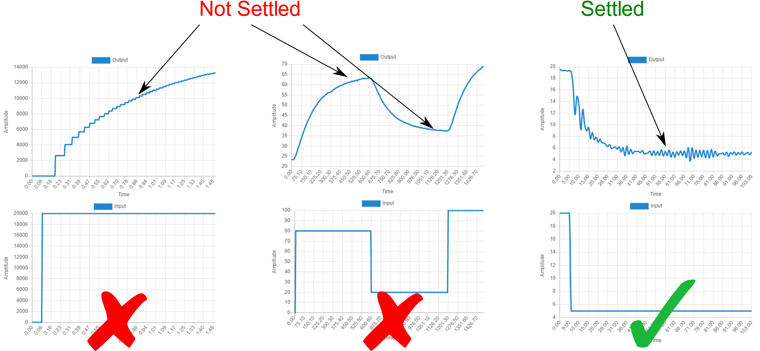
How long should I record?
The step test must contain the full PV transition from one operating point to another, until settled.
Some processes do not settle after a CV change (more on this later).

Slide 9
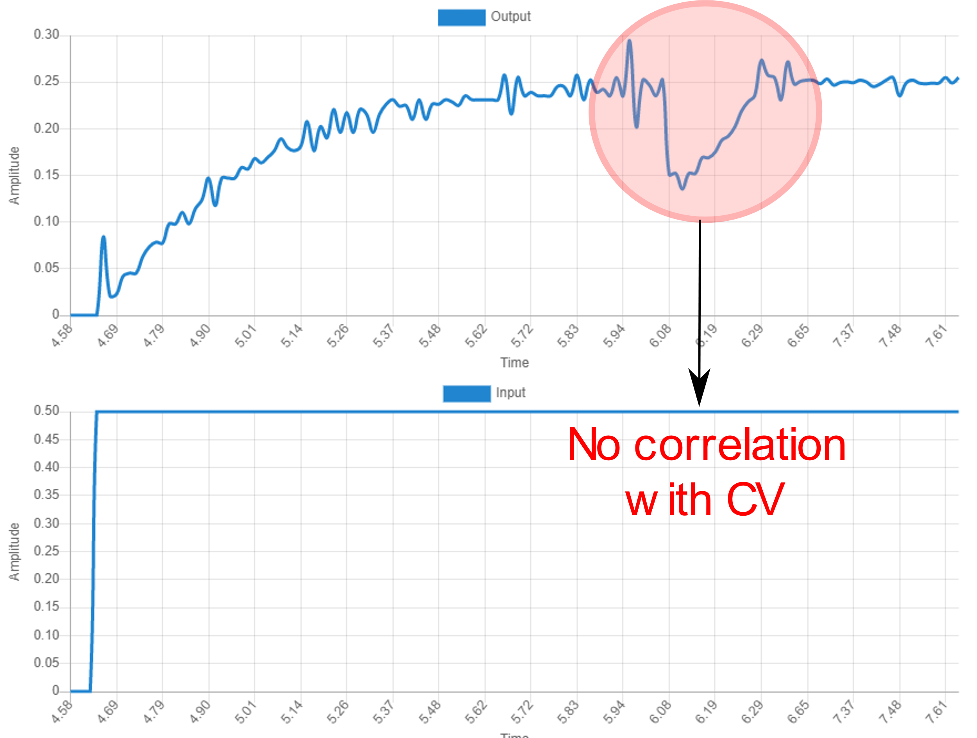
Common Mistakes on Step Test
We are trying to train a model to learn only the effect that the CV has over the PV.
Other loops or variables that affect the PV must be disabled, or fixed to a typical operating value.

Slide 10
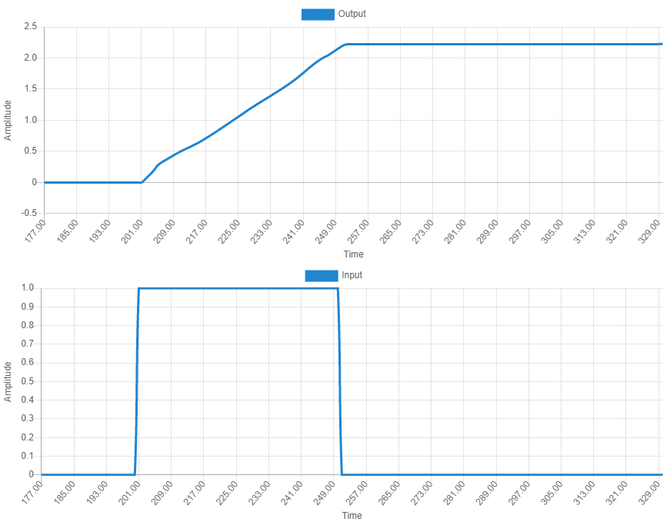
Integrating Process
What PV does not settle, but keeps increasing or decreasing (when CV not 0)?
This is an “integrating” process. Only settles when CV = 0.
Ex: a tank level (PV) keeps increasing when the intake valve (CV) is open (CV not 0), only settles when valve is closed (CV = 0).

Slide 11
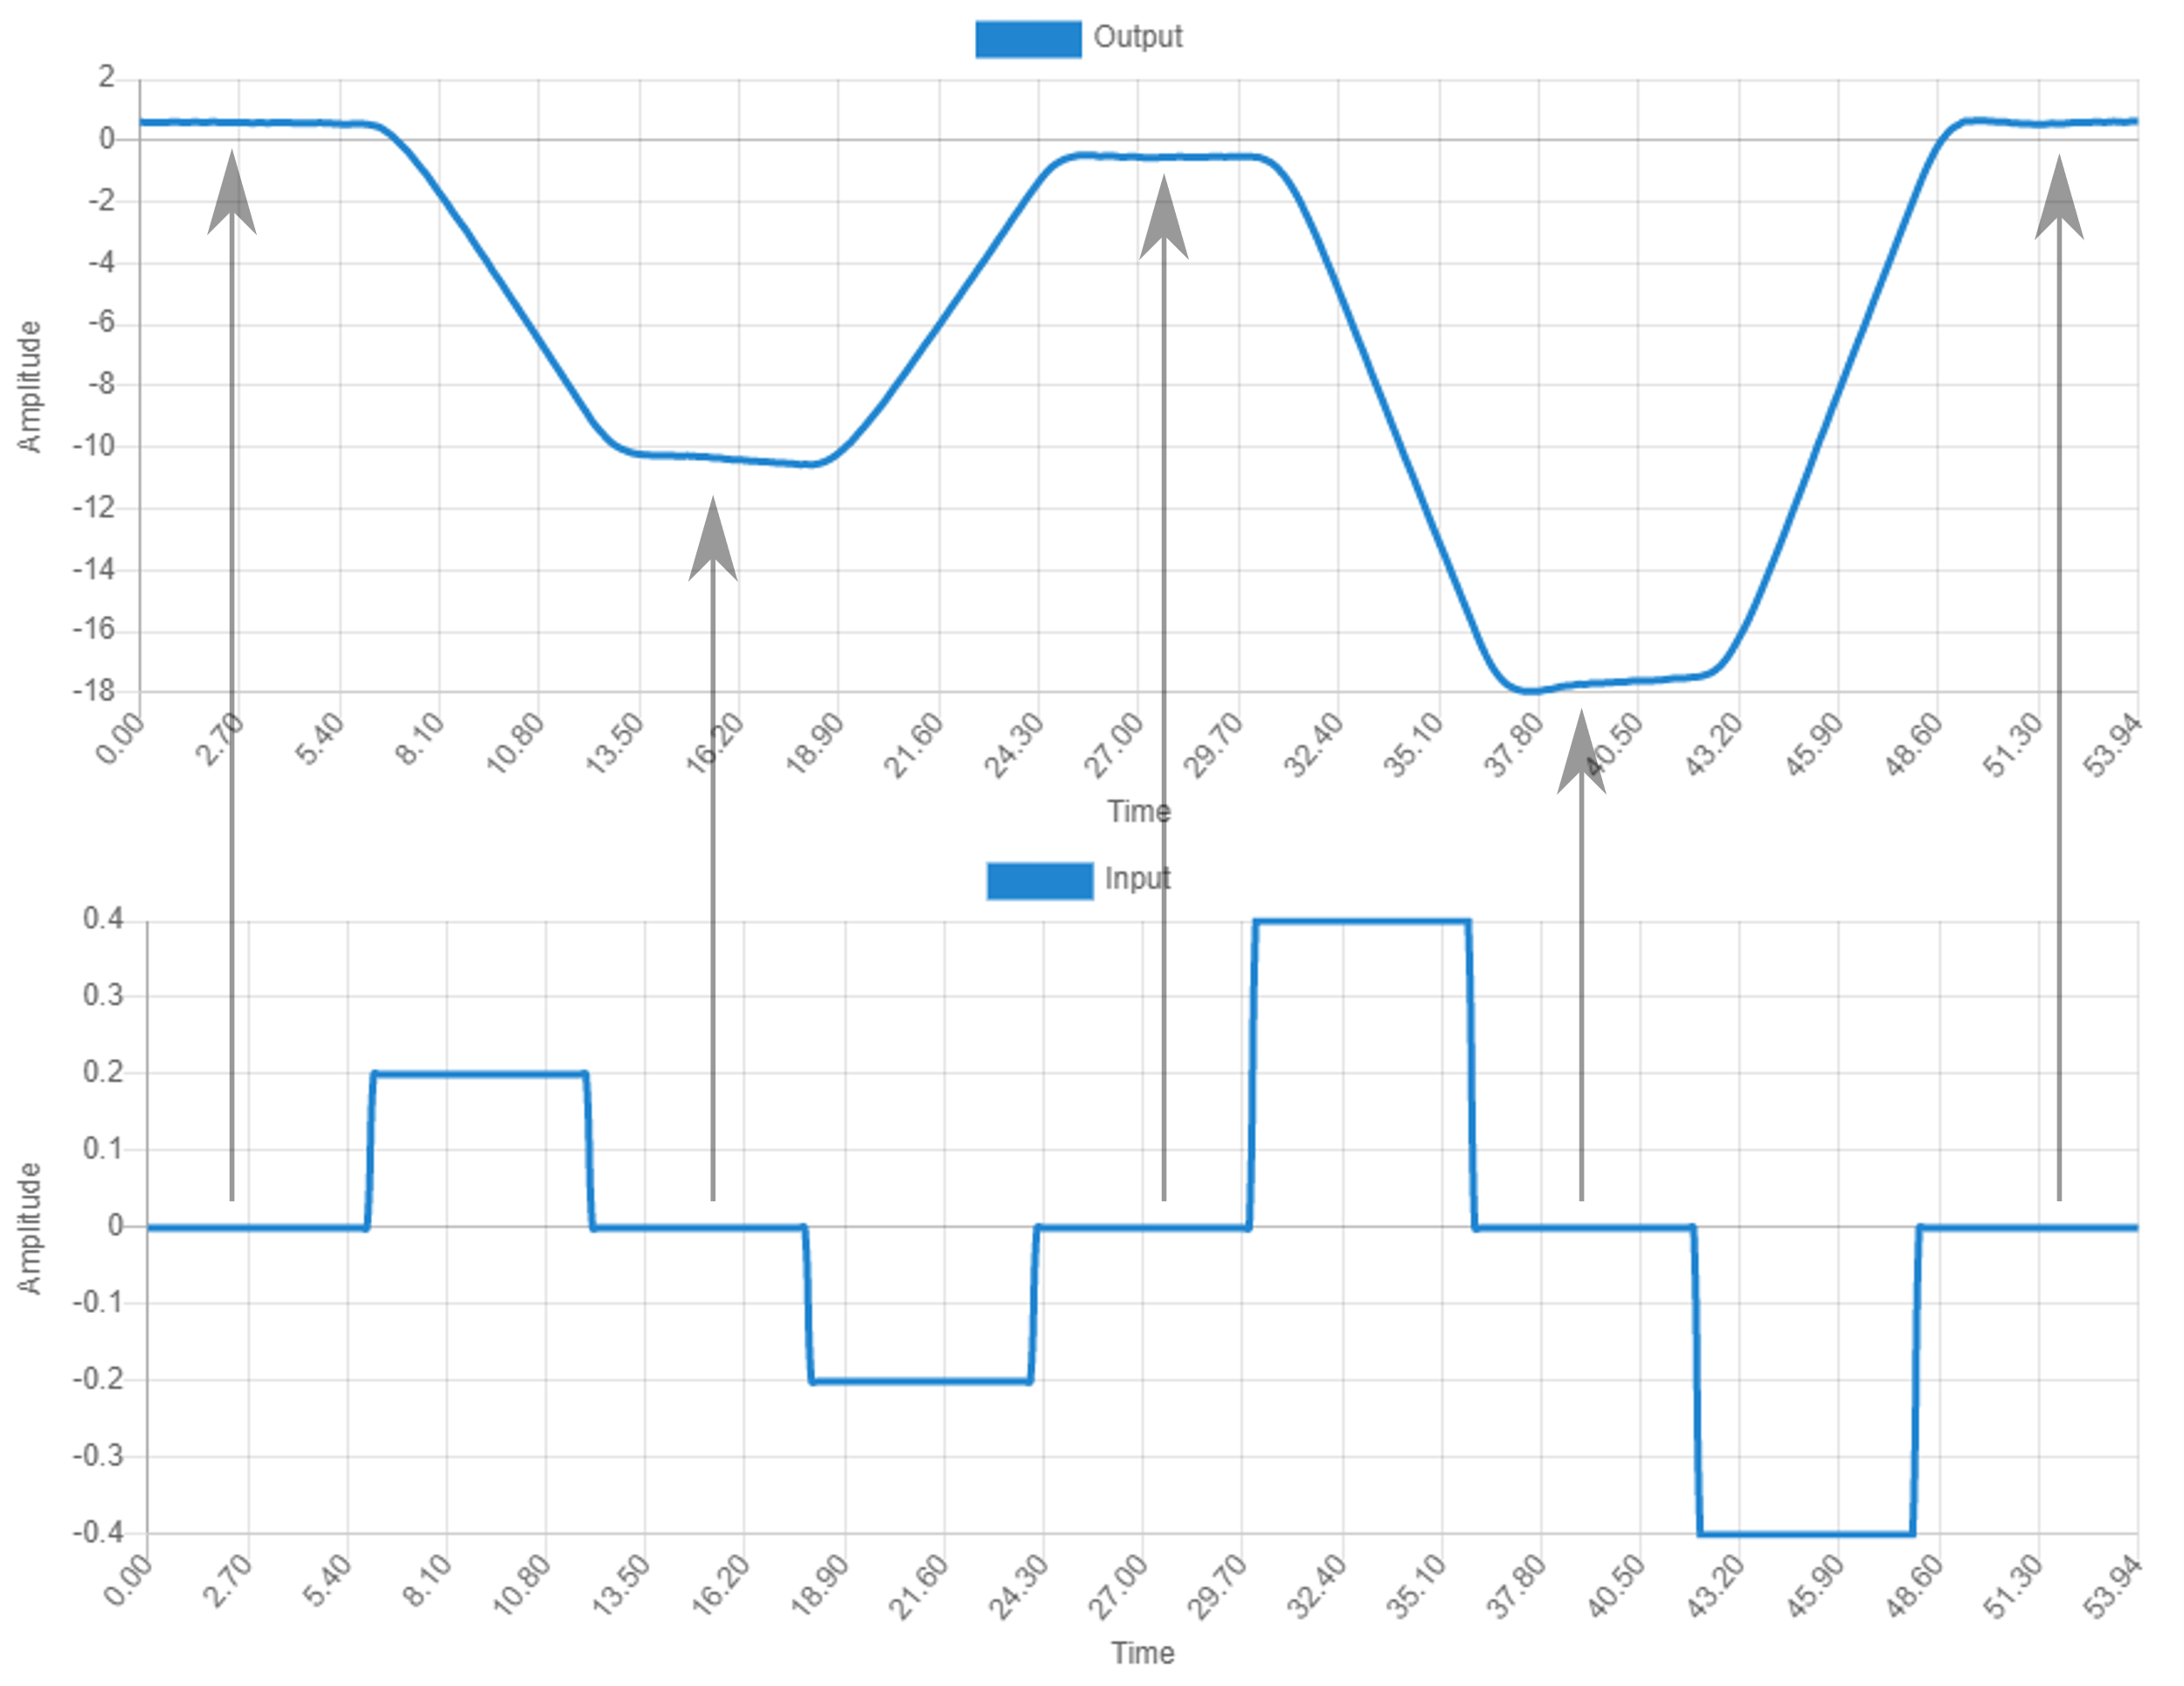
Step Test for an Integrating Process
A step test can be designed with a series of step up and step down.
Take care of staying inside safe operating conditions.

Slide 12
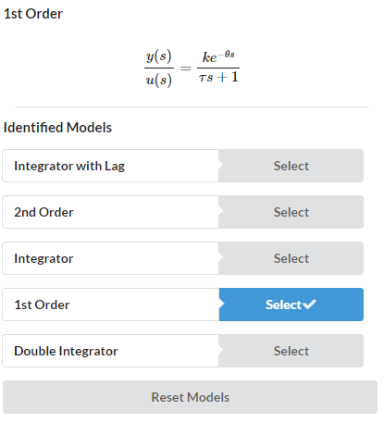
What are process models?
Processes can be categorized according to the PV response to a CV change.
A model is a (very useful) simplification of that response.

Slide 13
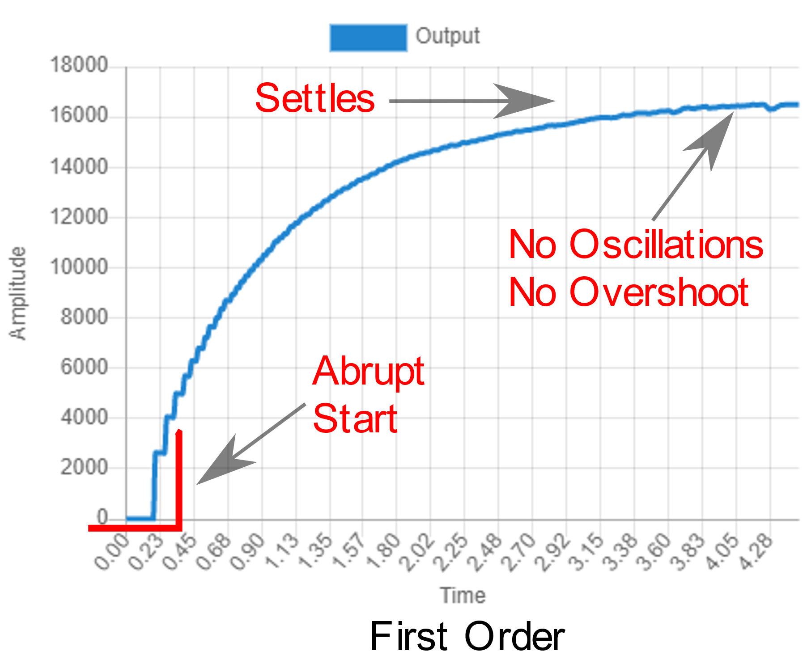
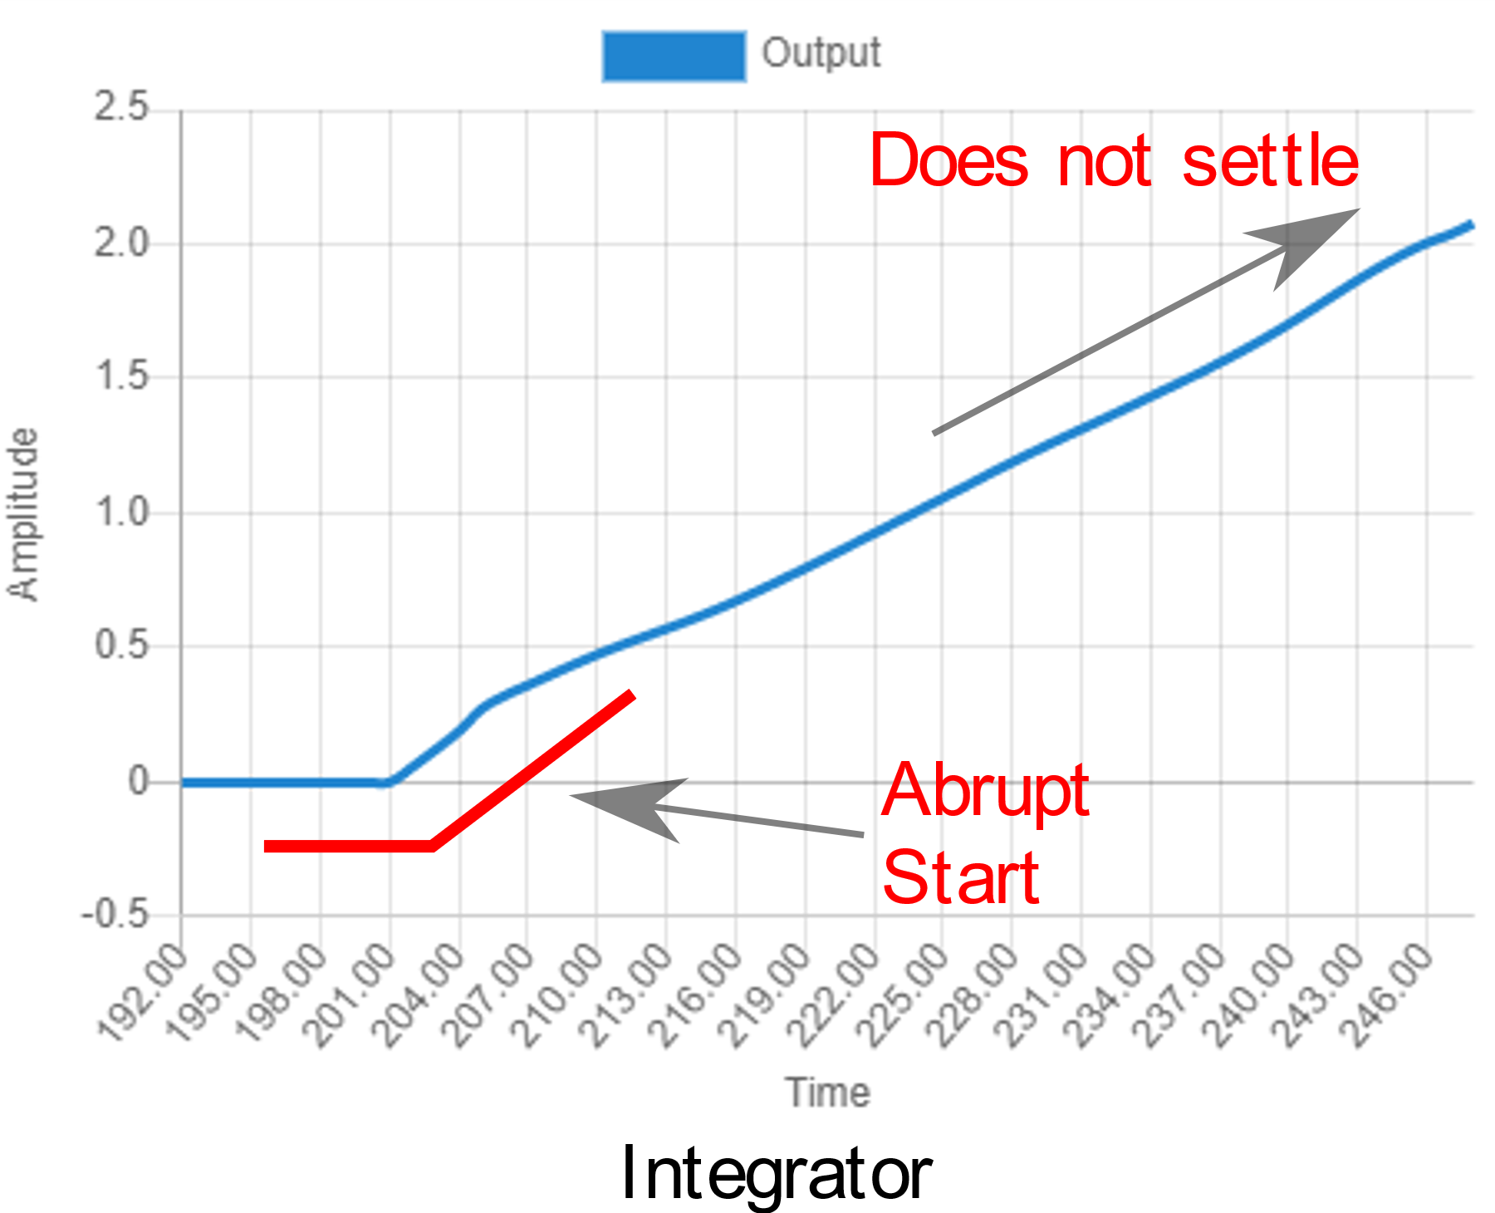
Models
First Order: PV abruptly transitions with exponential growth, but settles eventually.
Integrator: PV abruptly starts increasing (or decreasing) with a constant rate as long as CV is not 0, and does not settle.

Slide 14
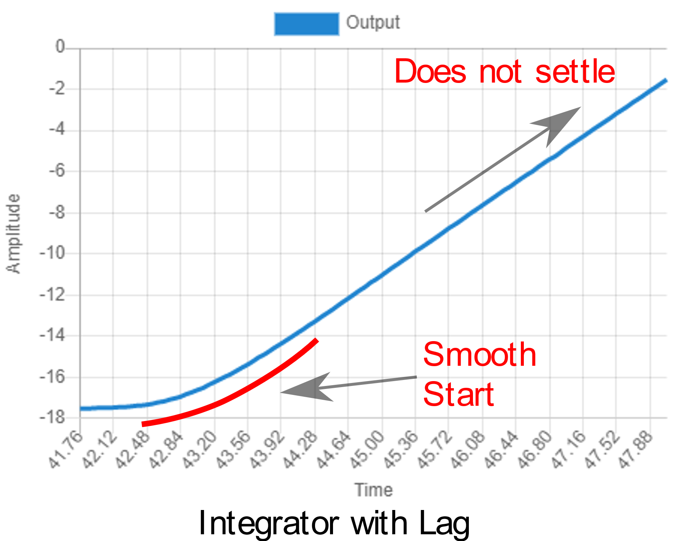
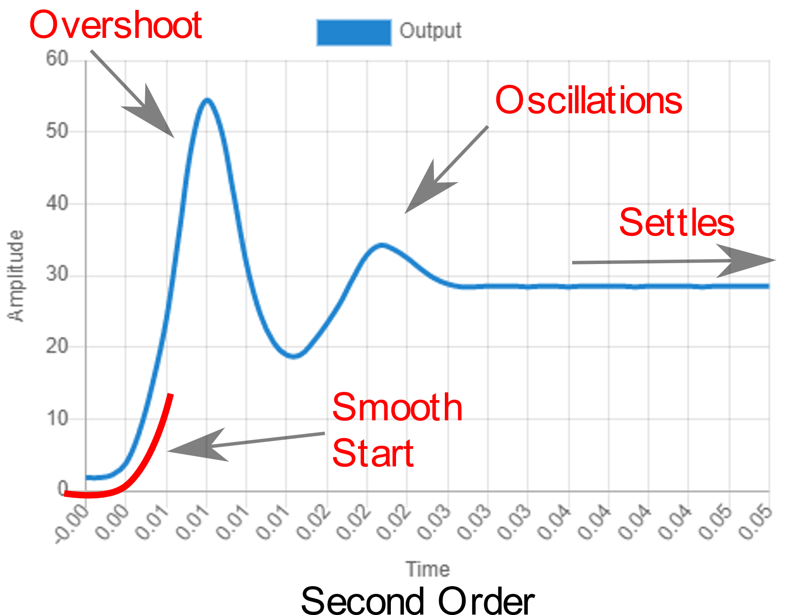
Models
Second Order: PV smoothly transitions with exponential growth, and might overshoot or show oscillations, then settles eventually.
Integrator with Lag: PV smoothly starts increasing (or decreasing) until reaching a constant rate (similar to an Integrator).

Slide 15
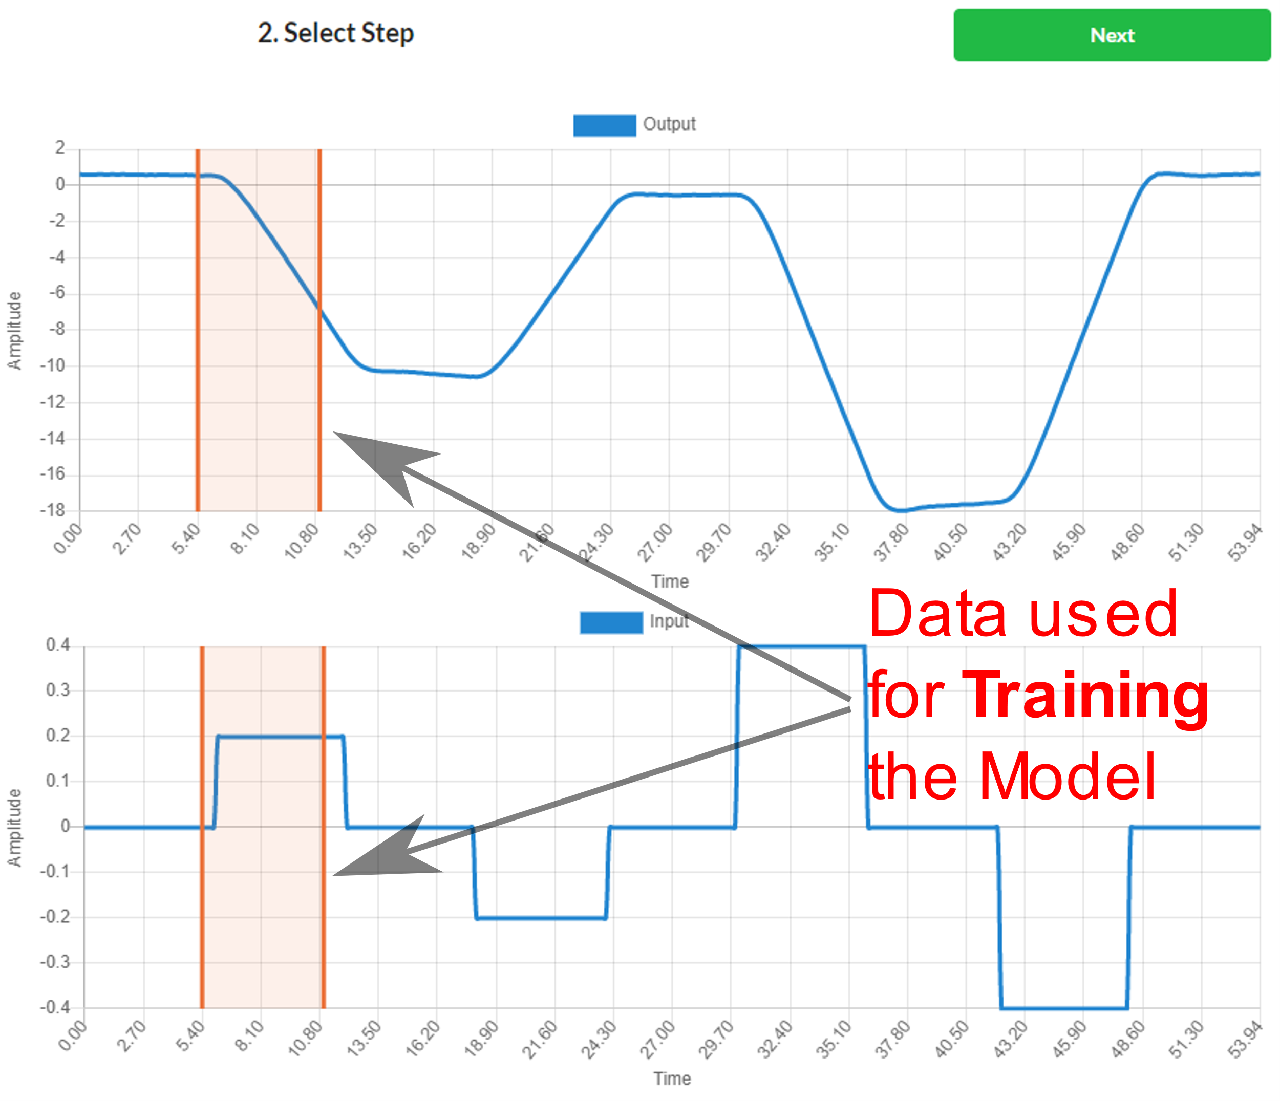
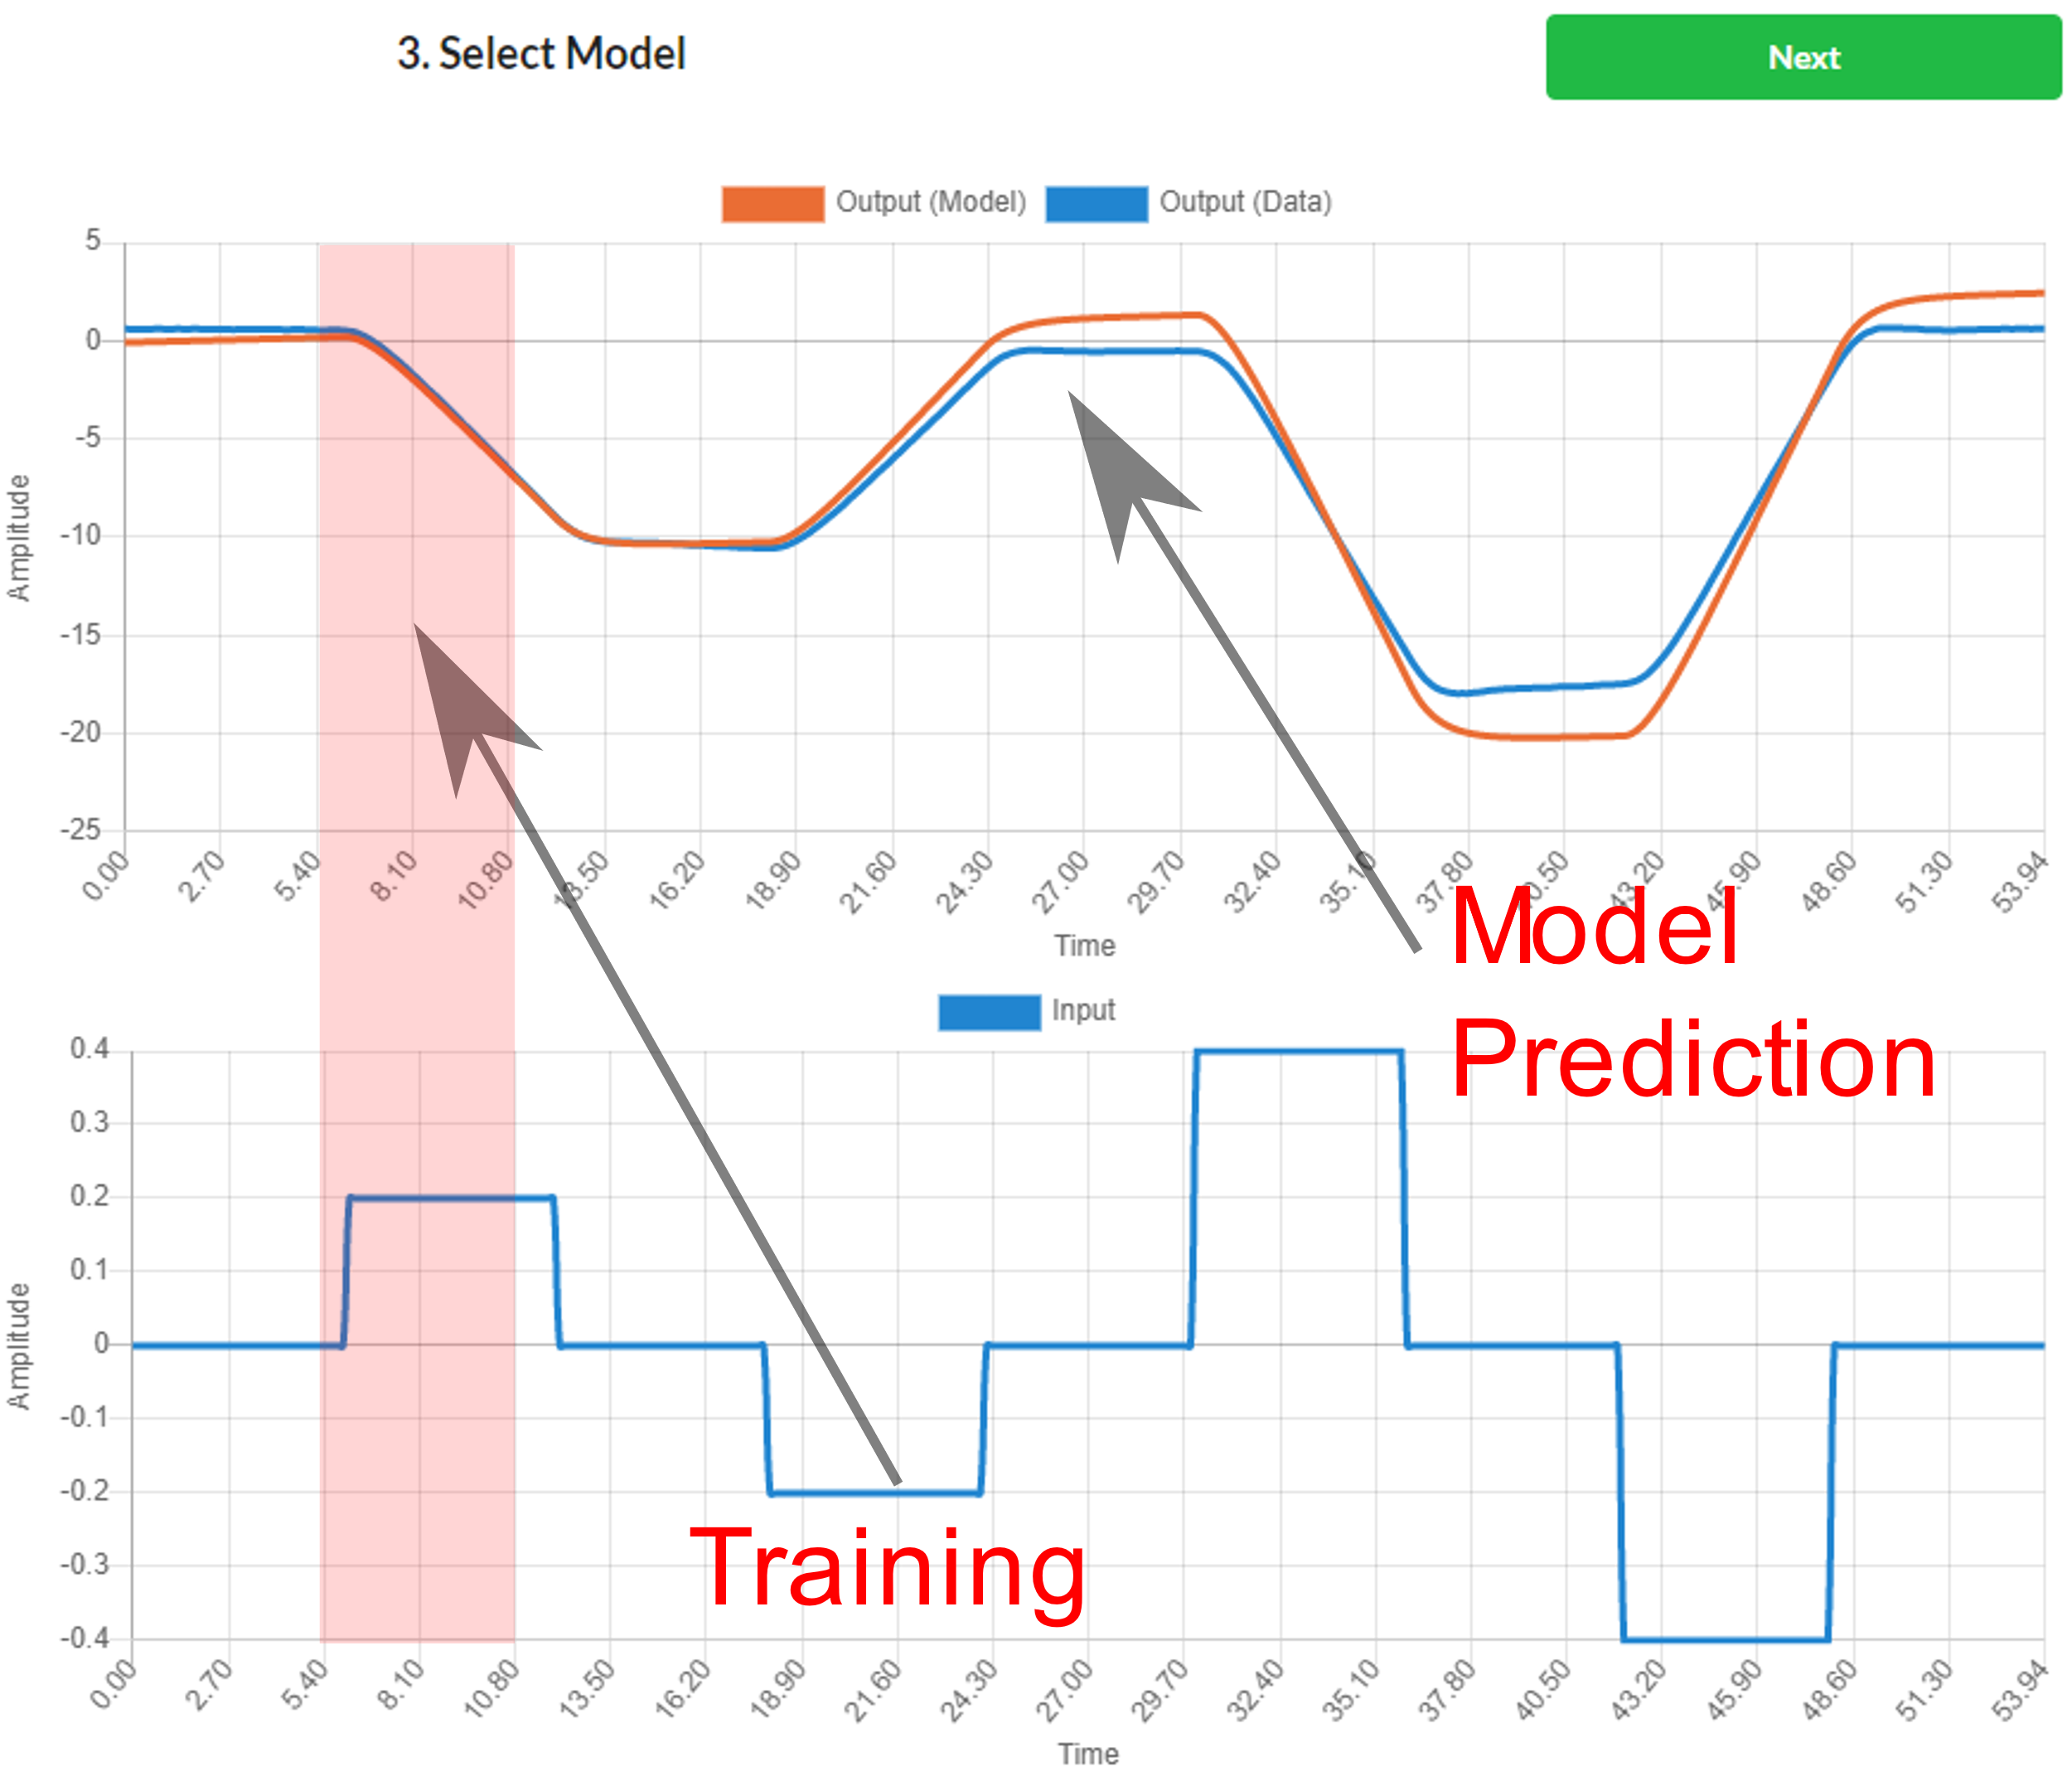
What are the models used for?
Capture the main dynamics of the process with a simplified model.
The model is used to adjust PID gains and make simulations.
Always choose the model that gives the best predictions.

Slide 16
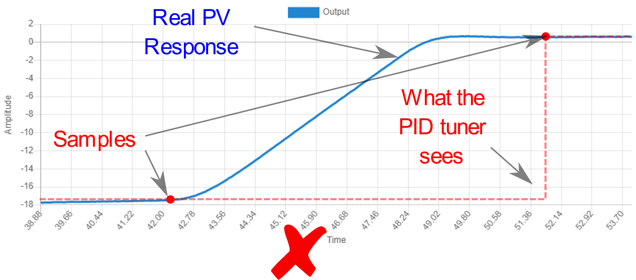
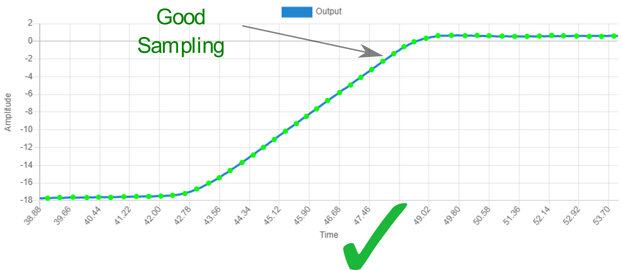
Data Sampling
The PID Tuner needs to see the full transition of the PV from one operating point to another.
If the data is under-sampled, the PID Tuner will not be able to see (therefore to learn) the process main dynamics.
Tip: at least 80 points for the transition.

Slide 17
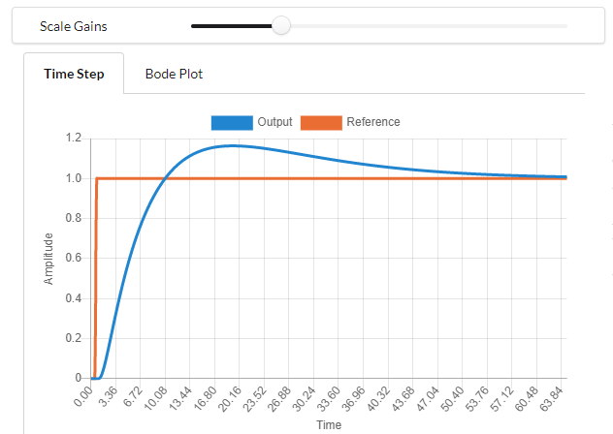
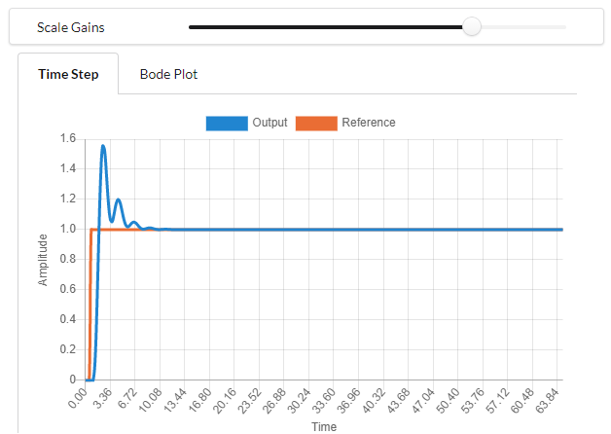
How to set the performance slider?
Models are not perfect by definition (they are a simplification).
The tuning slider reflects the confidence we have on the model.
Slider to the left means less confidence (less aggressive PID).
Slider to the right means more confidence (more aggressive PID).

Slide 18
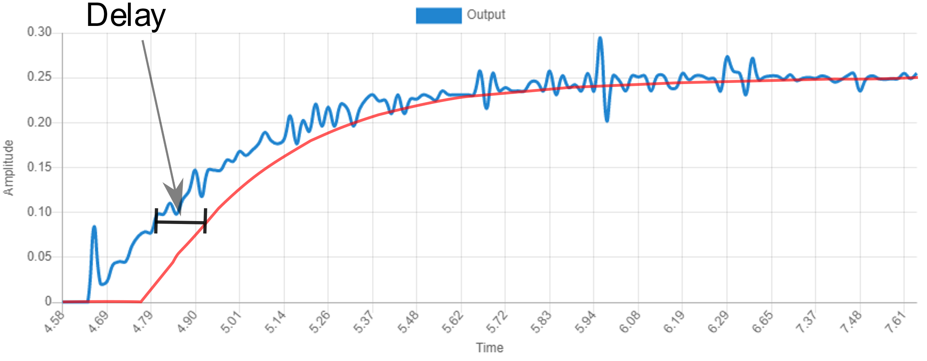
Note on Filters
Filters only hide the underlying problem; noise!
Filters introduce delay, delay degrades performance.

Slide 19
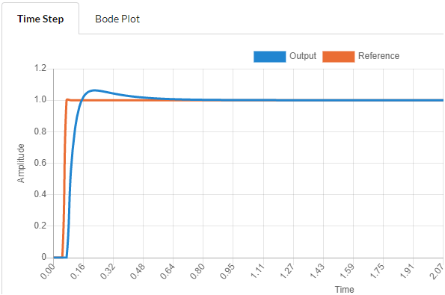
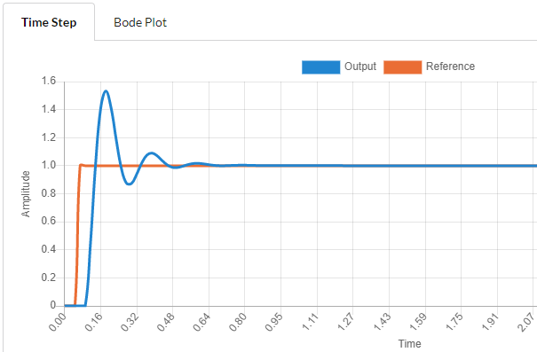
Note on Delay
Delay limits how far to the right we can set the PID Tuner performance slider (limits how aggressive we can control).
If we filter heavily, we have to accept slow control.
*Example: same process, same PID gains, just 0.02s delay difference

Slide 20
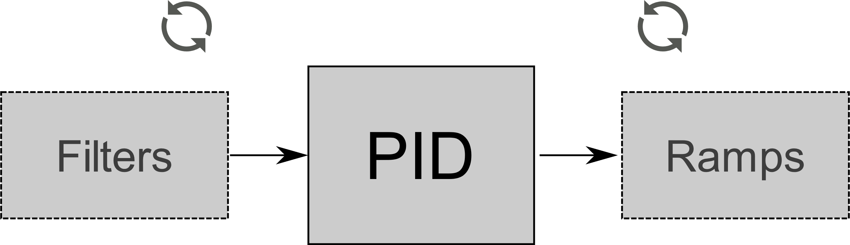
Filters and Step Test
If filters (ramps, scalings or other transformations) are changed, we need to repeat the step test.
Changes in filters, change what the PID “sees”, since the process changes in the eyes of the PID (remember process is everything that is not the PID).

Slide 21

How Acceptable is Noise?
Noisy PV measurements produce noisy PID signal (CV).
Noisy PV can be a big problem, specially when D gain is needed.
In some processes, feeding noise to the actuator can be dangerous.
Ex. Feeding a noisy signal to the motors of a quadcopter drone produces so much heat, it can burn the electronics.

Slide 22
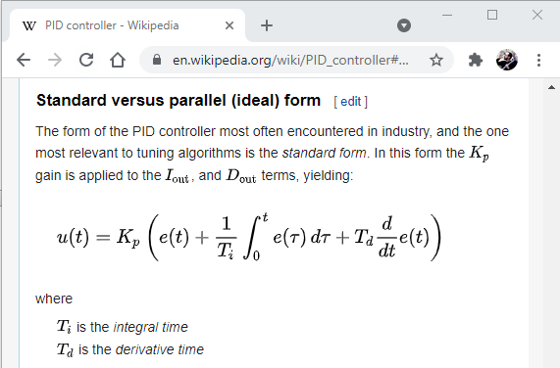
Non-standard PIDs
The PID Tuner assumes the standard or ideal form of the PID.
Some PID implementations use non-standard PID gains.
Might need to convert the PID Tuner gains to non-standard.
Read your vendor’s PID block documentation.
https://en.wikipedia.org/wiki/PID_controller

Slide 23
Summary : Key Points
Step test must be from CV (process Input) to PV (process Output), with PID disabled (in manual).
Transition of PV must be sampled fast enough (at least 80 points for one transition). Time always in seconds.
Plan the step test safely, reducing external factors that affect the PV, make as many steps necessary to cover the operating range.

Slide 24



Summary : Key Points
If possible, fix noise at source. Set the PV filters before making the step test. Accept more filtering will limit performance.
Repeat step test if anything outside the PID changes (filters, ramps, etc). These changes require PID re-tuning.
Read your PID documentation. Convert gains as required.

